Slide 1

MAC BLOCKERS

Slide 2
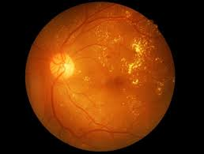
Diabetic Retinopathy Detection
Nischith T N
Parshwa B Patil
Nikhil Kumar V
Manik Gupta

Slide 3
What is Retinopathy?
Retinopathy is a condition which develops in the eye, which if not treated at early stages, could lead to permanent blindness.

Slide 4
Why do we care?
India is said to be the diabetic capital of the world by 2030 with over 80 million people affected by it.
If identified early, this is a blindness which can be avoided.

Slide 5
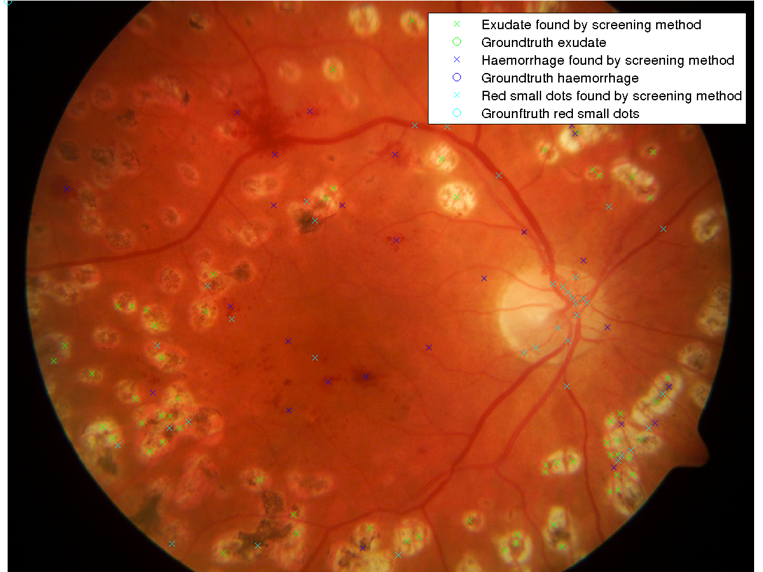
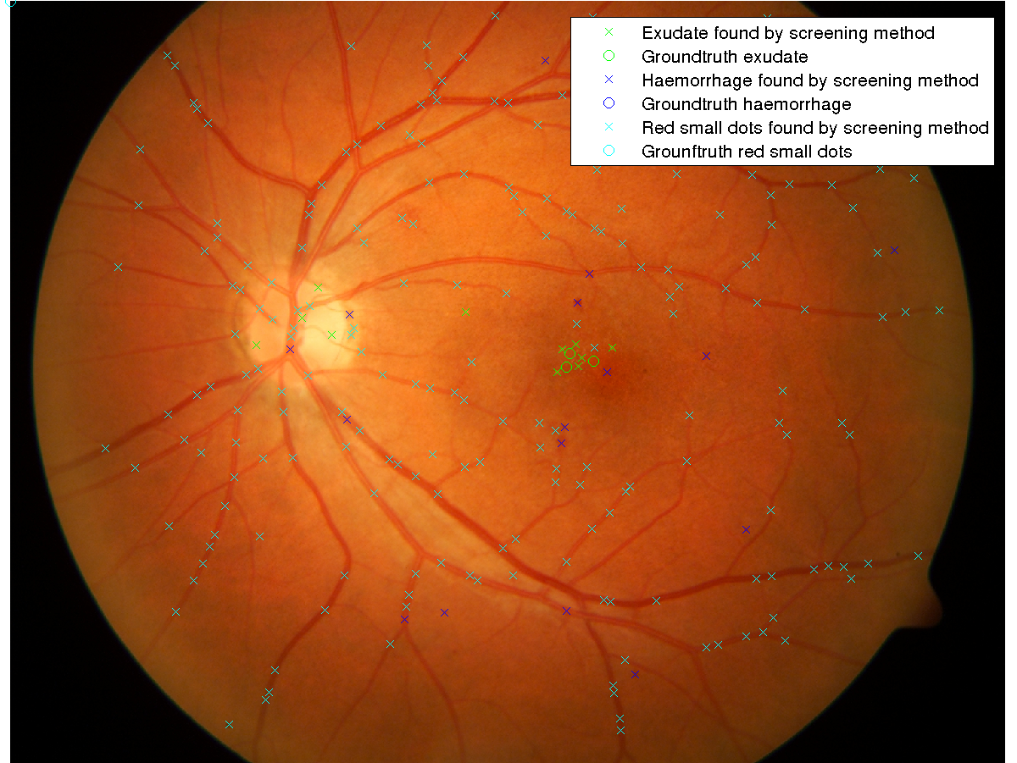
How are we caring?
Matching cases based on severity and time for immediate diagnosis.

Slide 6
Who is our product intended for?
For rural areas (Tier 4 cities), which has small dispensaries and can afford a fundus camera, but don’t have expert medical professionals available.
A tool for doctors to prioritise cases based on the severity of the condition.
For anyone who wants to make healthcare affordable and accurate.

Slide 7
Technical Roadmap of the System
Gather datasets
Build a Deep learning model
Look at deployment strategies
Build a user interface for the app
Utilise the new data to make the model better

Slide 8
Business Plans
Profit sharing, by helping in public health care campaigns, with local hospitals
Charging a very nominal amount for using the software at dispensaries.
Notes:
Predictions at the edge, there by reducing money spent on data privacy concerns

Slide 9
Future Directions:
Deploy on edge devices
Predict more than 5 stage diabetic retinopathy, like other biological conditions based on the retinal image.
Split Learning and Differential Privacy to preserve privacy.

Slide 10
Thank You

